Slide 1


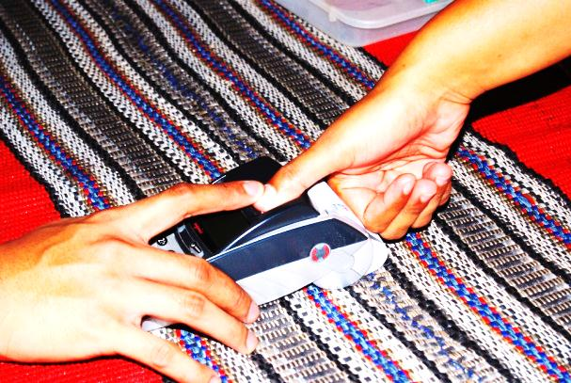
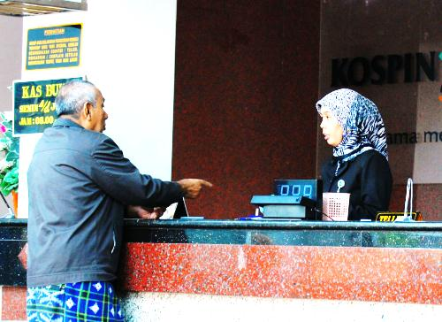




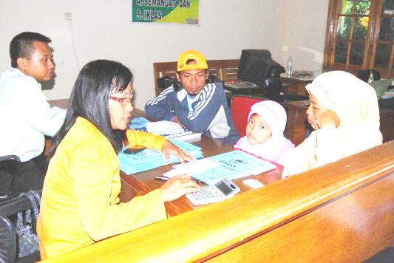



AKUNTANSI PERBANKAN SYARIAH
Ahmad Subagyo

Slide 2

SPEAKER P R O F I L E
Ahmad Subagyo
Chairman of NIBA Business School
Finance & Market Consultant of the WB
Committe Member of BOC PT. Pupuk Kujang
Books Writer
Trainer

Slide 3

Role of the Games 1st
Don’t Sleep !

Slide 4

Role of the Games 2nd

Slide 5

Role of the Games 3rd

Slide 6
TOPICS TO DISCUSS
No | Topik
1 | Pengantar Perbankan Syariah
2 | Akad-akad Syariah
3 | Produk Bank Syariah
4 | Perhitungan Bagi hasil
5 | Dasar Akuntansi Syariah
6 | Kerangka Dasar Laporan
7 | Laporan Keuangan Syariah
8 | UTS
9 | Akad Murabahah
10 | Akad Salam
11 | Akad Istishna
12 | Akad Mudharabah
13 | Akad Musyarakah
14 | Akad Ijarah
15 | Latihan Soal
16 | UAS

Slide 7

Ask me about your problem, please

