Slide 2
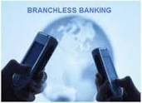



TOWARD BRANCHLESS BANKING
Jakarta, 23-24 Juni 2015
Hotel Santika Slipi
Ahmad Subagyo

Slide 3

PERKENALAN

Slide 4

P R O F I L NARASUMBER
Ahmad Subagyo
Chairman of GICI Business School
Researcher of The World Bank
Komite Risiko PT.Pupuk Kujang, Tbk
Books Writer
Trainer
Prepared by Dr. Ahmad Subagyo ------------------------------------------ www.ahmadsubagyo.com

Slide 5
AGENDA
OUTLINE:
Permasalahan Ekonomi dan Sosial
Rencana Strategik Regulator
Financial Inclusion
4. e-money
Mobil Banking
Conclusion

